Slide 1



Sockets and Plugs
Extensibility without boilerplate
Stability without stagnation
Code examples available at
diffplug.com/opensource
Ned Twigg
@nedtwigg
DiffPlug
@diffplug

Slide 2
The Plan
Build a calculator in Eclipse (using Equinox Extension Registry)
How does “classic” Eclipse extensibility work?
“Declarative” metadata
Maven vs Gradle
Describe a system which hides the boilerplate
AutOSGi (based on OSGi-DS)
Stability without stagnation
How to migrate a socket without breaking plugs

Slide 3
Our calculator
public interface Operator {
double calculate(double... args);
}
public class OperatorDescriptor {
public String getName();
public Operator getInstance();
public static List<OperatorDescriptor> all();
public static OperatorDescriptor forName(String name);
}

Slide 4
Our calculator in eclipse
public interface Operator {
double calculate(double... args);
}
plugin.xml
Listing of all implementations,
by conforming to grammar
schema/operator.exsd
Grammar for specifying metadata
public class OperatorDescriptor {
public String getName();
public Operator getInstance();
public static List<OperatorDescriptor> all();
public static OperatorDescriptor forName(String name);
}

Slide 5
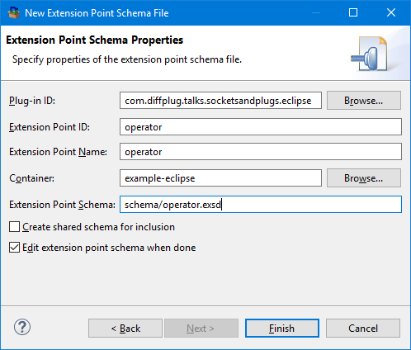
Let’s make a schema
public class OperatorDescriptor {
public String getName()
public Operator getInstance()
}

Slide 6
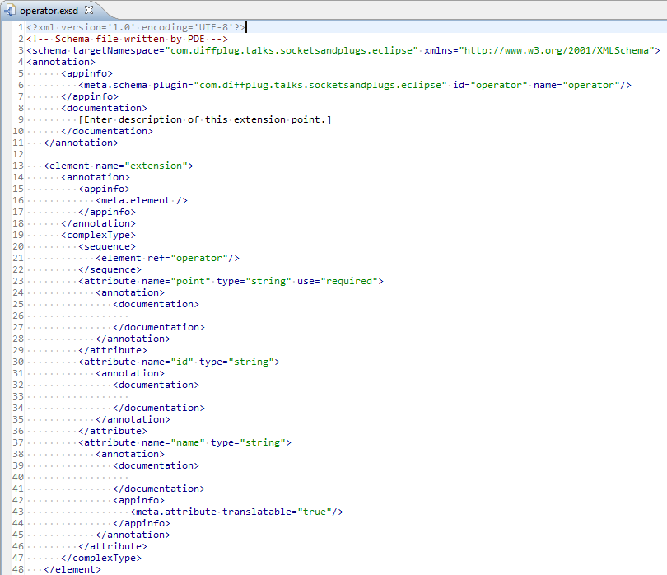
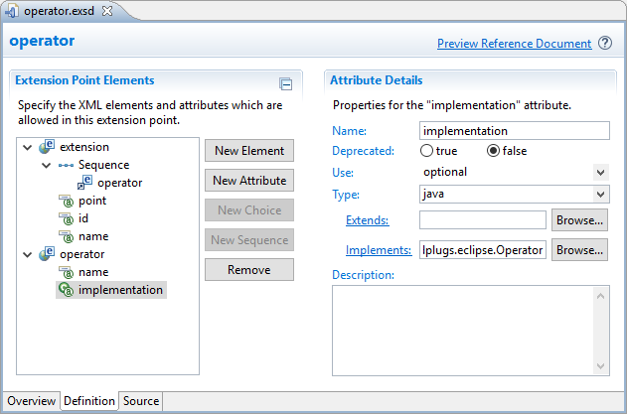
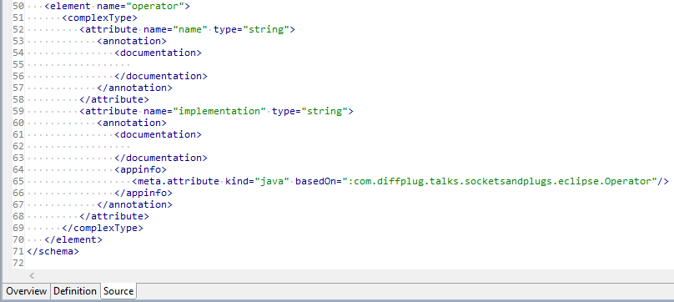
Let’s make a schema
public class OperatorDescriptor {
public String getName()
public Operator getInstance()
}

Slide 7
Let’s make a schema
public class OperatorDescriptor {
public String getName()
public Operator getInstance()
}
schema/operator.exsd

Slide 8
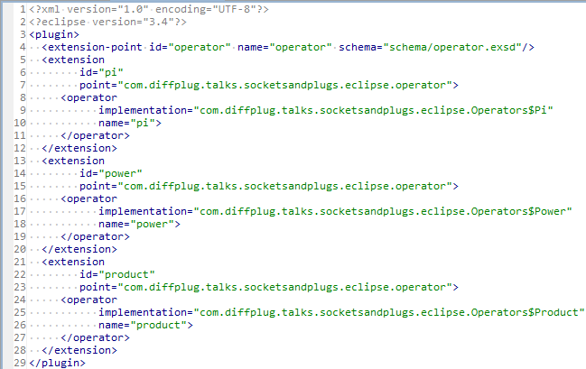
Let’s make a plug for our socket
public class OperatorDescriptor {
public String getName()
public Operator getInstance()
}
public class Pi implements Operator {
double calculate(double... args) {
return 3.14159;
}
}
schema/operator.exsd
plugin.xml

Slide 9
How do we read the plugin.xml?
public class OperatorDescriptor {
public String getName()
public Operator getInstance()
}
public class Pi implements Operator {
double calculate(double... args) {
return 3.14159;
}
}
schema/operator.exsd
plugin.xml

Slide 10
How do we read the plugin.xml?
plugin.xml
public class OperatorDescriptor {
public String getName()
public Operator getInstance()
public static List<OperatorDescriptor> all()
public static OperatorDescriptor forName(String name)
}

Slide 11
How do we read the plugin.xml?
plugin.xml
public class OperatorDescriptor {
public String getName()
public Operator getInstance()
public static List<OperatorDescriptor> all()
public static OperatorDescriptor forName(String name)
}
public class OperatorDescriptor {
…
/** Returns all the OperatorDescriptors in the project. */
public static List<OperatorDescriptor> all() {
IExtensionPoint point = Platform.getExtensionRegistry().getExtensionPoint(
"com.diffplug.talks.socketsandplugs.eclipse.operator");
IExtension[] extensions = point.getExtensions();
return Arrays.asList(extensions).stream()
.map(OperatorDescriptor::new)
.collect(Collectors.toList());
}
…
}

Slide 12
How do we read the plugin.xml?
plugin.xml
public class OperatorDescriptor {
public String getName()
public Operator getInstance()
public static List<OperatorDescriptor> all()
public static OperatorDescriptor forName(String name)
}
public class OperatorDescriptor {
private final String name;
private final String implementation;
private OperatorDescriptor(IExtension element) {
IConfigurationElement configElement = element.getConfigurationElements()[0]
name = configElement.getAttribute("name");
implementation = configElement.getAttribute("implementation");
}
…
}

Slide 13
How do we read the plugin.xml?
plugin.xml
public class OperatorDescriptor {
public String getName()
public Operator getInstance()
public static List<OperatorDescriptor> all()
public static OperatorDescriptor forName(String name)
}
public class OperatorDescriptor {
…
private Operator instance;
public Operator instantiate() {
if (instance != null) {
return instance;
} else {
Class<?> clazz = Class.forName(implementation);
instance = (Operator) clazz.newInstance();
return instance;
}
}
…
}

Slide 14
Eclipse (Equinox Extension Registry)
schema/socket.exsd
Not that human-friendly XML schema
Eclipse has a nice editor for it
plugin.xml
Contains XML chunks that match the schema
SocketDescriptor.java
Parses the XML and handles the details of the chunks

Slide 15
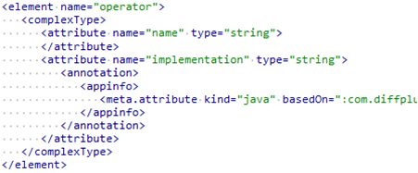
How does it all fit together?
Socket Interface
Contract that the Plug must satisfy
Metadata Format
Contract that the Metadata must satisfy
CONSTRAINS _
CONSTRAINS
public interface Operator {
double calculate(double... args);
}
schema/operator.exsd
Socket Descriptor
API for declarative metadata
INSTANTIATES
PARSES
public class OperatorDescriptor {
public String getName();
public Operator getInstance();
public static List<OperatorDescriptor> all();
public static OperatorDescriptor forName(String name);
}
Metadata
Declarative description of the plug
Plug Implementation
Implements the Socket Interface
plugin.xml
public class Pi implements Operator {
double calculate(double... args) {
return 3.14159;
}
}

Slide 16
What is “declarative” metadata?
declare according to dictionary.com
to make known or state clearly, especially in explicit or formal terms
to manifest; reveal; show

Slide 17
Which is more declarative?
to make known or state clearly, especially in explicit or formal terms
to manifest; reveal; show
A)
B)
C)
[1, 2, 3, 4]
List<Integer> list = new ArrayList<>();
for (int i = 1; i <= 4; ++i) {
list.add(i);
}
range(1, 4)

Slide 18
Which is more declarative?
to make known or state clearly, especially in explicit or formal terms
to manifest; reveal; show
A)
B)
C)
[1, 2, 3, 4, 5, 6, 7, 8, 9, 10, 11, 12, 13, 14, 15, 16, 17, 18, 19, 20, 21, 22, 23, 24, 25, 26, 27, 28, 29, 30, 31, 32, 33, 34, 35, 36, 37, 38, 39, 40, 41, 42, 43, 44, 45, 46, 47, 48, 49, 50, 51, 52, 53, 54, 55, 56, 57, 58, 59, 60, 61, 62, 63, 69, 65, 66, 67, 68, 69, 70, 71, 72, 73, 74, 75, 76, 77, 78, 79, 80, 81, 82, 83, 84, 85, 86, 87, 88, 89, 90, 91, 92, 93, 94, 95, 96, 97, 98, 99, 100]
List<Integer> list = new ArrayList<>();
for (int i = 1; i <= 100; ++i) {
list.add(i);
}
range(1, 100)

Slide 19
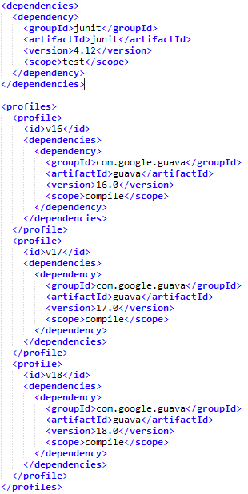
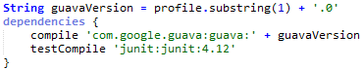
Maven vs Gradle

Slide 20
How does it all fit together?
Socket Interface
Contract that the Plug must satisfy
Metadata Format
Contract that the Metadata must satisfy
CONSTRAINS _
CONSTRAINS
public interface Operator {
double calculate(double... args);
}
schema/operator.exsd
Socket Descriptor
API for declarative metadata
INSTANTIATES
PARSES
public class OperatorDescriptor {
public String getName();
public Operator getInstance();
public static List<OperatorDescriptor> all();
public static OperatorDescriptor forName(String name);
}
Metadata
Declarative description of the plug
Plug Implementation
Implements the Socket Interface
plugin.xml
public class Pi implements Operator {
double calculate(double... args) {
return 3.14159;
}
}

Slide 21
How are the implementations constrained?
Socket Interface
Contract that the Plug must satisfy
Metadata Format
Contract that the Metadata must satisfy
CONSTRAINS _
CONSTRAINS
public interface Operator {
double calculate(double... args);
}
schema/operator.exsd
Socket Descriptor
API for declarative metadata
INSTANTIATES
PARSES
public class OperatorDescriptor {
public String getName();
public Operator getInstance();
public static List<OperatorDescriptor> all();
public static OperatorDescriptor forName(String name);
}
Metadata
Declarative description of the plug
Plug Implementation
Implements the Socket Interface
plugin.xml
public class Pi implements Operator {
double calculate(double... args) {
return 3.14159;
}
}

Slide 22
How are the implementations constrained?
Socket Interface
Contract that the Plug must satisfy
Socket Descriptor
API for declarative metadata about each Plug
CONSTRAINS _
CONSTRAINS
INSTANTIATES
PARSES
public interface Operator {
double calculate(double... args);
}
public class OperatorDescriptor {
public String getName();
public Operator getInstance();
public static List<OperatorDescriptor> all();
public static OperatorDescriptor forName(String name);
}
PARSES
Metadata
Declarative description of the plug
Plug Implementation
Implements the Socket Interface
plugin.xml
public class Pi implements Operator {
double calculate(double... args) {
return 3.14159;
}
}

Slide 23
Declarative metadata
Socket Interface
Contract that the Plug must satisfy
Socket Descriptor
API for declarative metadata about each Plug
CONSTRAINS _
CONSTRAINS
INSTANTIATES
PARSES
public interface Operator {
double calculate(double... args);
}
public class OperatorDescriptor {
public String getName();
public Operator getInstance();
public static List<OperatorDescriptor> all();
public static OperatorDescriptor forName(String name);
}
GENERATES
PARSES
Implementation Detail
Mostly hidden from the developer
Metadata
Declarative description of the plug
Plug Implementation
Implements the Socket Interface
plugin.xml
public class Pi implements Operator {
double calculate(double... args) {
return 3.14159;
}
}

Slide 24
Declarative generated metadata - AutOSGi
Socket Interface
Contract that the Plug must satisfy
Socket Descriptor
API for declarative metadata about each Plug
CONSTRAINS
INSTANTIATES
PARSES
public interface Operator {
double calculate(double... args);
}
public class OperatorDescriptor {
public String getName();
public Operator getInstance();
public static List<OperatorDescriptor> all();
public static OperatorDescriptor forName(String name);
}
GENERATES
PARSES
Implementation Detail
Mostly hidden from the developer
Metadata
Declarative description of the plug
Plug Implementation
Implements the Socket Interface
plugin.xml
public class Pi implements Operator {
double calculate(double... args) {
return 3.14159;
}
}

Slide 25
AutOSGi
public interface Operator {
double calculate(double... args);
}
public class OperatorDescriptor {
public String getName();
public Operator getInstance();
public static List<OperatorDescriptor> all();
public static OperatorDescriptor forName(String name);
}
public class Pi implements Operator {
double calculate(double... args) {
return 3.14159;
}
}

Slide 26
AutOSGi
public interface Operator {
String name();
double calculate(double... args);
}
public class OperatorDescriptor {
public String getName();
public Operator getInstance();
public static List<OperatorDescriptor> all();
public static OperatorDescriptor forName(String name);
}
@Plug(Operator.class)
public class Pi implements Operator {
public String name() { return "pi" }
public double calculate(double... args) {
return 3.14159;
}
}
Function<Operator, Metadata>
Function<Operator, Map<String, String>>
class OperatorMetadataCreator extends
DeclarativeMetadataCreator<Operator> {
OperatorMetadataCreator() {
super(Operator.class, instance -> {
return ImmutableMap.of("name", instance.name());
});
}
}
Build steps
Find all classes annotated with @Plug(Socket.class)
Find class named SocketMetadataCreator
Instantiate the MetadataCreator and Plug
Pass the Plug to the MetadataCreator to get a Map<String, String>
Write out the metadata as an OSGi Declarative Service

Slide 27
Minor migration (1.0 -> 1.1)
public interface Operator {
String name();
double calculate(double... args);
default Range<Integer> numArgs() {
return Range.of(0, Integer.MAX_VALUE);
}
}
public class OperatorDescriptor {
public String getName();
public Operator getInstance();
public Range<Integer> getNumArgs();
public static List<OperatorDescriptor> all();
public static OperatorDescriptor forName(String name);
public static List<OperatorDescriptor> forArgs(int numArgs);
}
@Plug
public class Pi implements Operator {
public String name() { return "pi" }
public double calculate(double... args) {
return 3.14159;
}
public Range<Integer> numArgs() {
return Range.ofClosed(0, 0);
}
}
class OperatorMetadataCreator extends
DeclarativeMetadataCreator<Operator> {
OperatorMetadataCreator() {
super(Operator.class, instance -> {
return ImmutableMap.of("name", instance.name(),
"numArgs",instance.numArgs().toString());
});
}
}

Slide 28
Major migration (1.1 -> 2.0)
public interface Operator {
String name();
Future<Double> calculate(double... args);
default Range<Integer> numArgs() {
return Range.of(0, Integer.MAX_VALUE);
}
}
public class OperatorDescriptor {
public String getName();
public Operator getInstance();
public Range<Integer> getNumArgs();
public static List<OperatorDescriptor> all();
public static OperatorDescriptor forName(String name);
public static List<OperatorDescriptor> forArgs(int numArgs);
}
@Plug
public class Pi implements Operator {
public String name() { return "pi" }
public Future<Double> calculate(double... args) {
return Futures.immediate(3.14159)
}
public Range<Integer> numArgs() {
return Range.ofClosed(0, 0);
}
}
class OperatorMetadataCreator extends
DeclarativeMetadataCreator<Operator> {
OperatorMetadataCreator() {
super(Operator.class, instance -> {
return ImmutableMap.of("name", instance.name(),
"numArgs",instance.numArgs().toString());
});
}
}

Slide 29
Code examples available at
diffplug.com/opensource
Ned Twigg
@nedtwigg
DiffPlug
@diffplug

Slide 30
Stuff after this is for supporting questions / other ways to support the talk

Slide 31
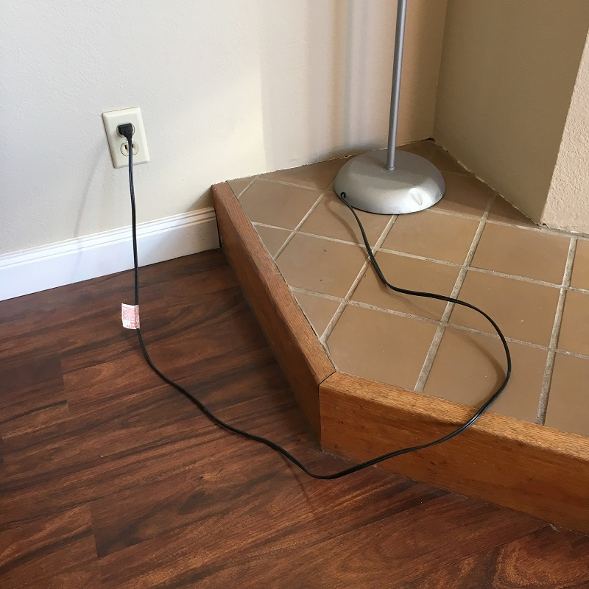
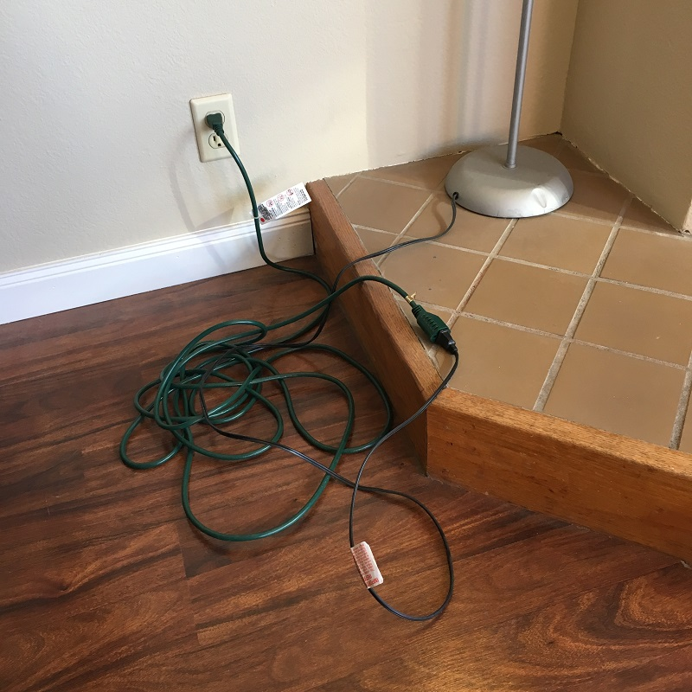
Future-proofing
Notes:
Many sockets have been written which only have one plug, with the idea that we are “future-proofing”.
YAGNI. You Aint Gonna Need It.

Slide 32



OSGi: Conflict diamonds
Guava

Slide 33

Boilerplate
Notes:
Image used with permission: https://www.flickr.com/mail/72157671594455393

Slide 34
IntelliJ
Components (eagerly-loaded)
Application, Project, Module
Services (lazily-loaded)
Same divisions as components, but loaded lazily
Actions
Declarative similar to VSCode’s commands
Used to be lazy-loaded, now eagerly-loaded (ref)
Extension Points and Extensions

Slide 35
Eclipse
e4
Modeled workbench
Describe application with XML
Includes declarative commands/handlers
Sits on top of OSGi
Services
Declarative services
Very powerful, very complex
Extension Points and Extensions

Slide 36
1, 1,
0, 1,
1, 2,
2 Fibonacci
1 Fibonacci again
3 Numbers
Notes:
“Congress shall make no law respecting an establishment of religion, or prohibiting the free exercise thereof; or abridging the freedom of speech, or of the press; or the right of the people peaceably to assemble, and to petition the Government for a redress of grievances”
- Easy to articulate a principle which turns out to be ambiguous.
- Lawyer technique is to say something three times:
“I promise to tell the truth, the whole truth, and nothing but the truth”
“I give, devise, and bequeath”

Slide 37


The three rules of plugin APIs
1
3
2
PLUG
SOCKET

Slide 38
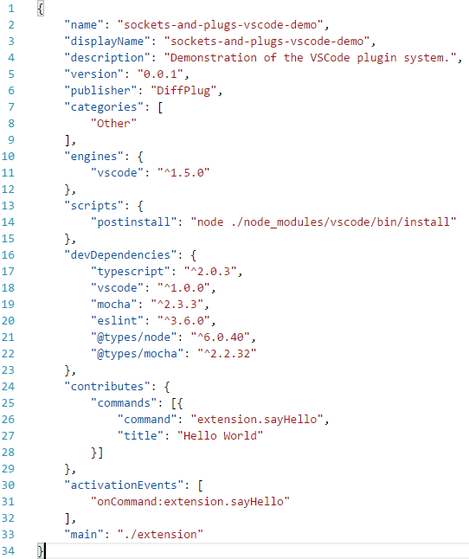
VSCode
package.json (extension manifest)
User-facing information
Similar to maven pom.xml
Dependency and build information
Plugin metadata
Notes:
VSCode -> Extension
Socket -> Contribution Point
Plug -> Contribution

Slide 39
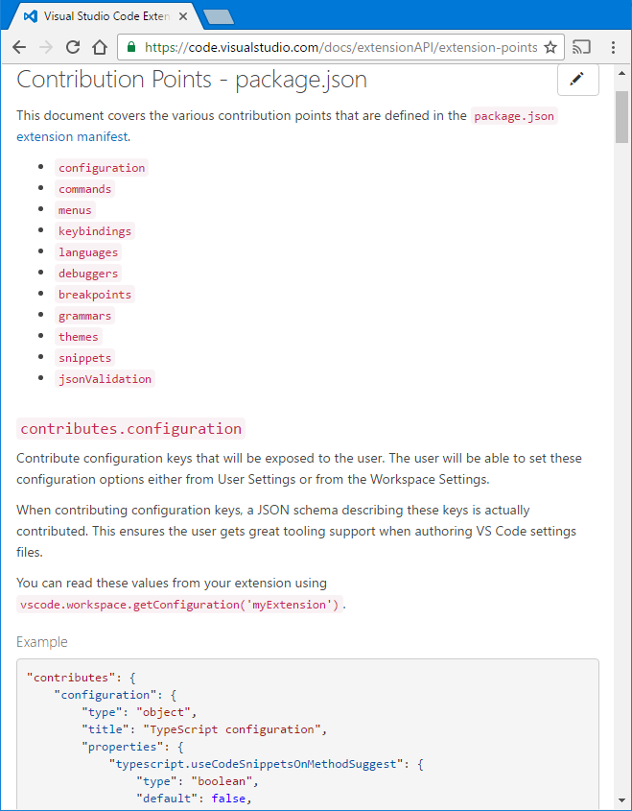
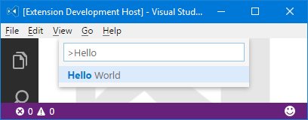
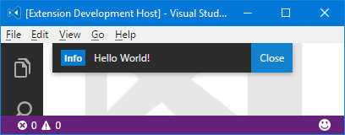
VSCode
package.json

Slide 40
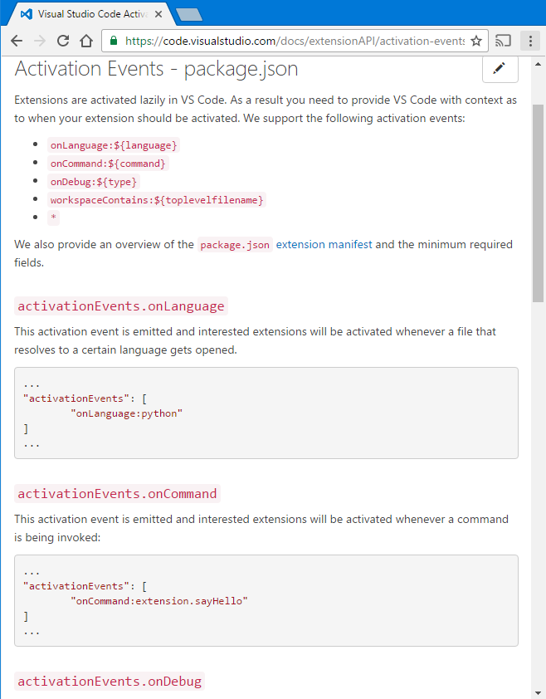
VSCode
package.json

Slide 41
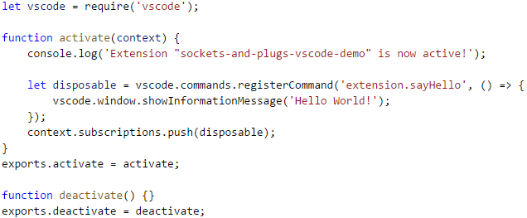
VSCode
extension.js
package.json

Slide 42
VSCode
package.json is a declarative description
What it contributes (to a fixed set of contribution points)
When to load the code (based on a fixed set of activationEvents)
Allows the code to be loaded lazily
Requires synchronizing package.json and the code

Slide 43
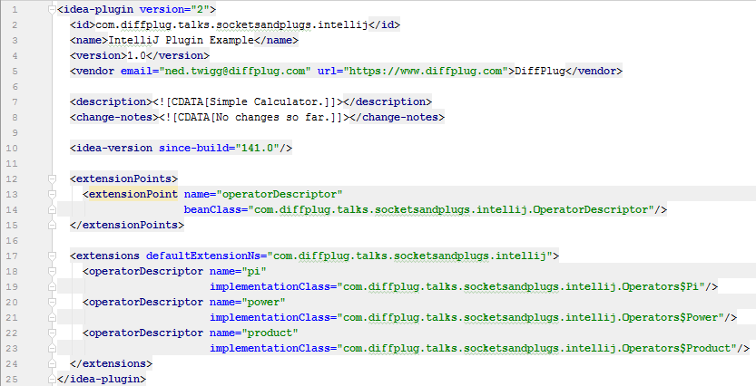
IntelliJ
plugin.xml
User-facing information
Extensions

Slide 44
IntelliJ
plugin.xml
public class OperatorDescriptor extends AbstractExtensionPointBean {
@Attribute("name")
public String name;
@Attribute("implementationClass")
public String implementation;
private Operator instance;
public Operator instantiate() {
if (instance != null) {
return instance;
} else {
Class<?> clazz = Class.forName(implementation);
instance = (Operator) clazz.newInstance();
return instance;
}
}
…

Slide 45
IntelliJ
plugin.xml
public class OperatorDescriptor extends AbstractExtensionPointBean {
…
/** Returns all the OperatorDescriptors in the project. */
public static List<OperatorDescriptor> all() {
ExtensionPointName<OperatorDescriptor> point = new ExtensionPointName<>(
"com.diffplug.talks.socketsandplugs.intellij.operatorDescriptor");
return Arrays.asList(point.getExtensions());
}
/** Returns all the OperatorDescriptors in the project. */
public static OperatorDescriptor forName(String name) {
return all().stream().filter(desc -> desc.name.equals(name)).findFirst().get();
}
}

Slide 46
IntelliJ
plugin.xml (extensionPoints)
<extensionPoint name="socketName" beanClass="SocketDescriptor"/>
SocketDescriptor.java
Extends AbstractExtensionPointBean
Marks attributes with @Attribute
plugin.xml (extensions)
<socketName attr1="value1" attr2="value2"/>

